Slide 1
Some Practice for R
Yiwei Zheng
郑逸炜
23220181152387

Slide 2
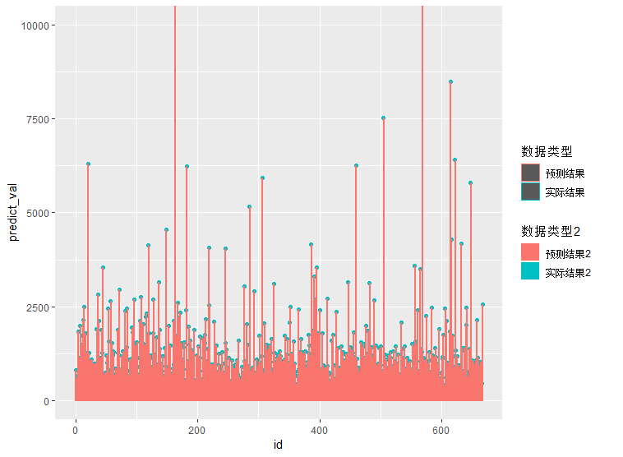
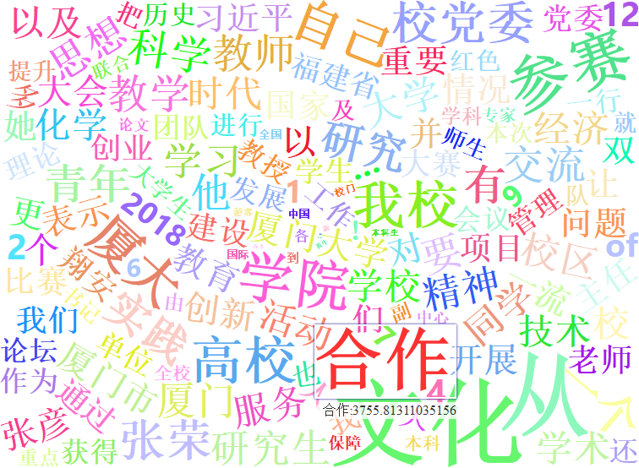
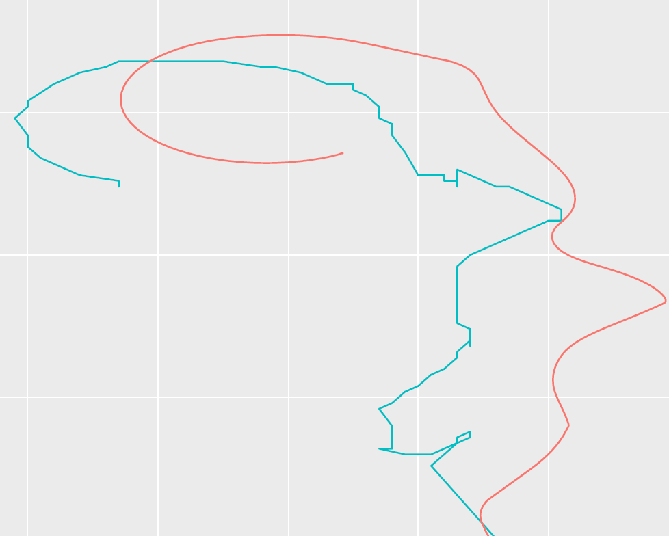
Practice Content & Codes
Some modification on the homework of the curriculum Bigdata, including:
real/predict data for the page view of Xiamen university (XMU) news
word cloud of those news
Plotting the trajectory estimated by the recent work of simultaneous localization and mapping (SLAM)

Slide 3
Practice Content & Codes
Two parts of the codes
Bigdata & data mining are in
https://github.com/trigger1996/R_homework
SLAM trajectory plotting is in
https://github.com/trigger1996/trajectory_plotter_demo

Slide 4
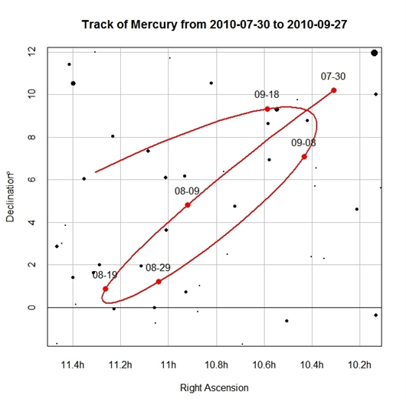
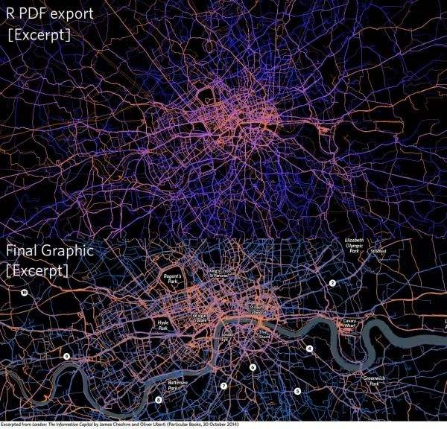
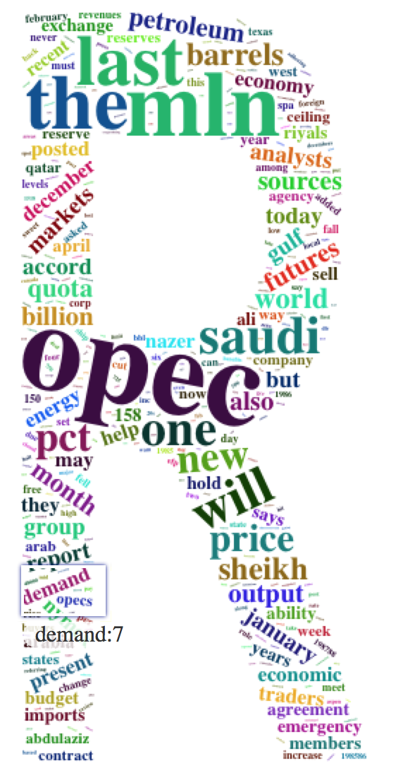
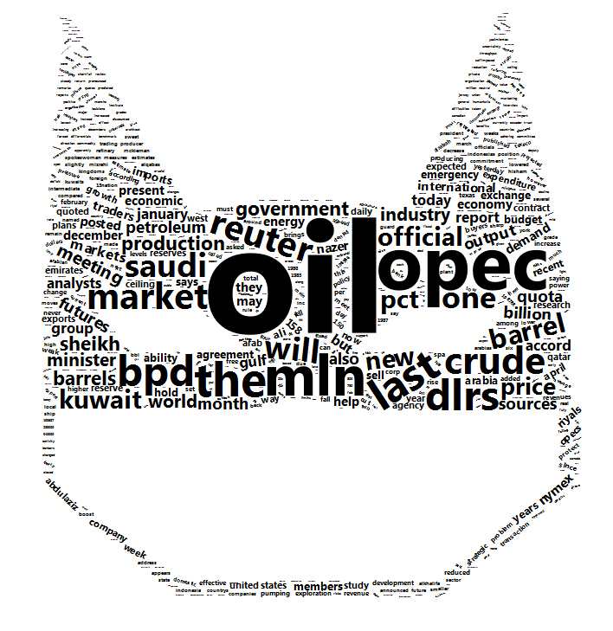
Why R plotting?
Needs of curriculum
Indeed beautiful

Slide 5
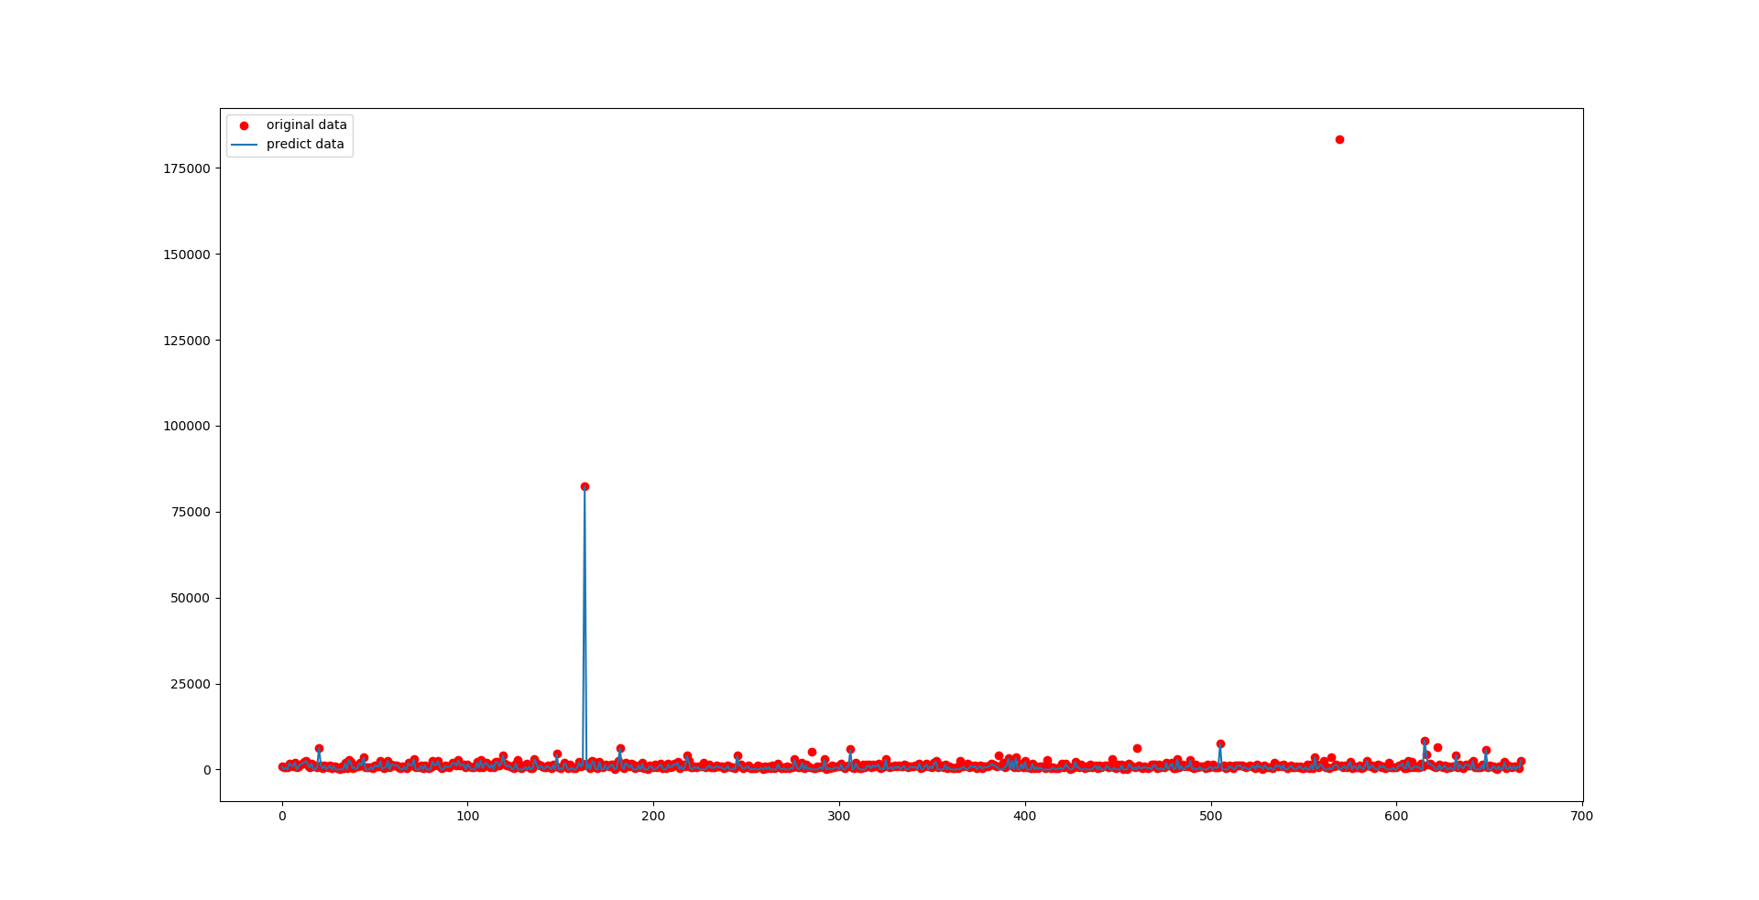
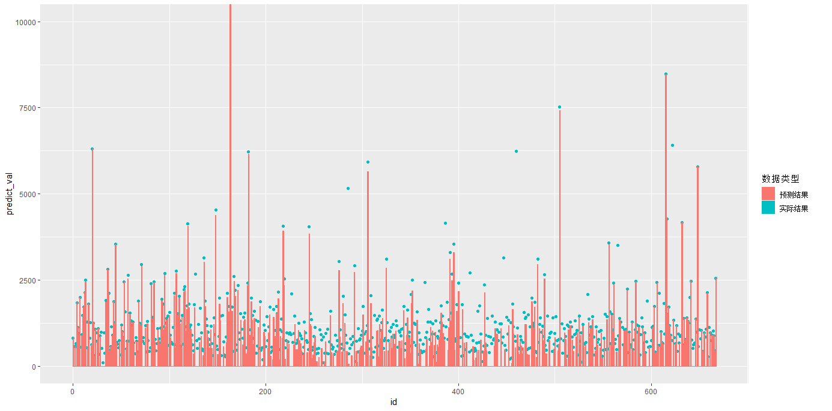
Why R plotting?
Python result Vs R result
Brighter colors
Available cutoff

Slide 6
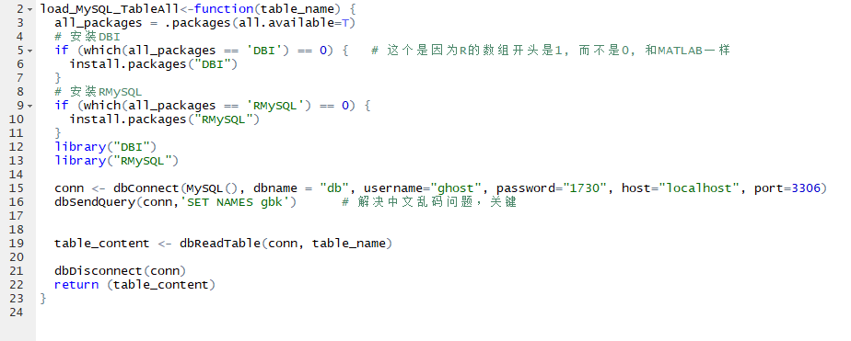
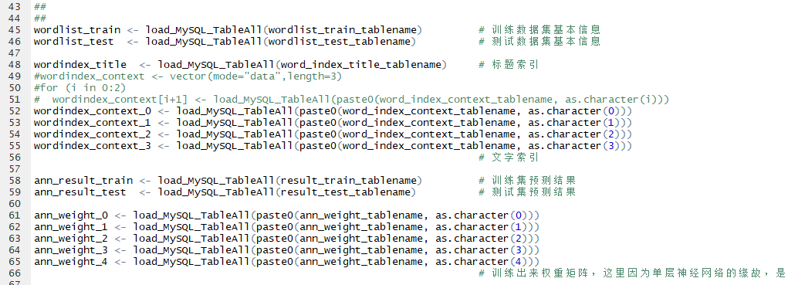
Process of Plotting
Python & R interaction
How to transfer data from python to R?
MySQL RMySQL
Text document Import data
Known issues
GBK to UTF8
1000 limits in MySQL
JUST Click your MOUSE!

Slide 7
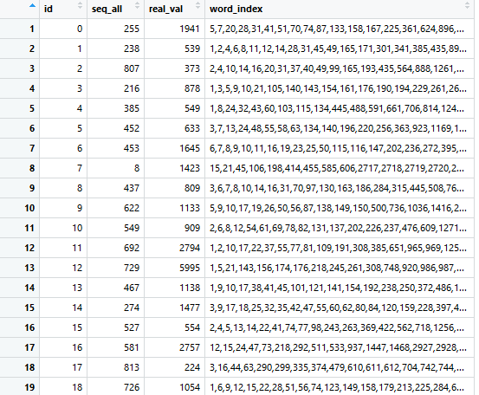
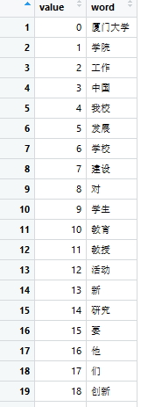
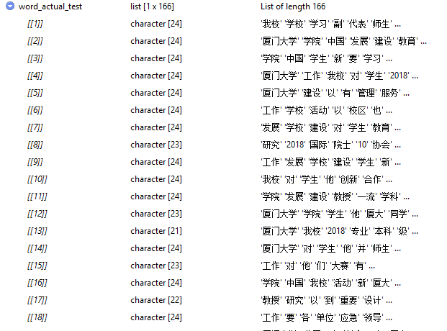
Process of Plotting
Data structure transform for words

Slide 8
Process of Plotting
Data structure transform for words

Slide 9
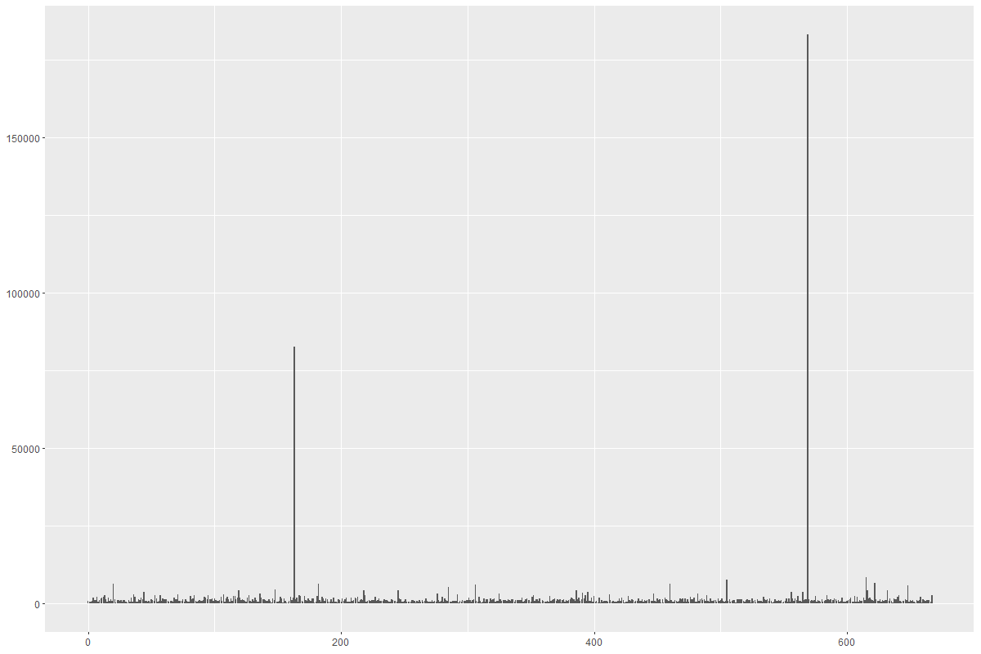
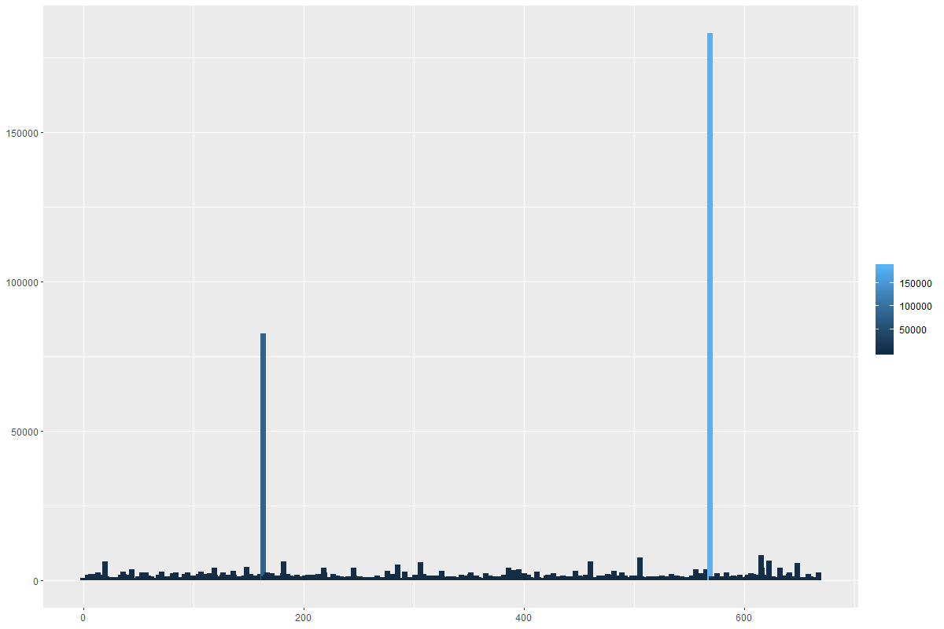
Process of Plotting

Slide 10
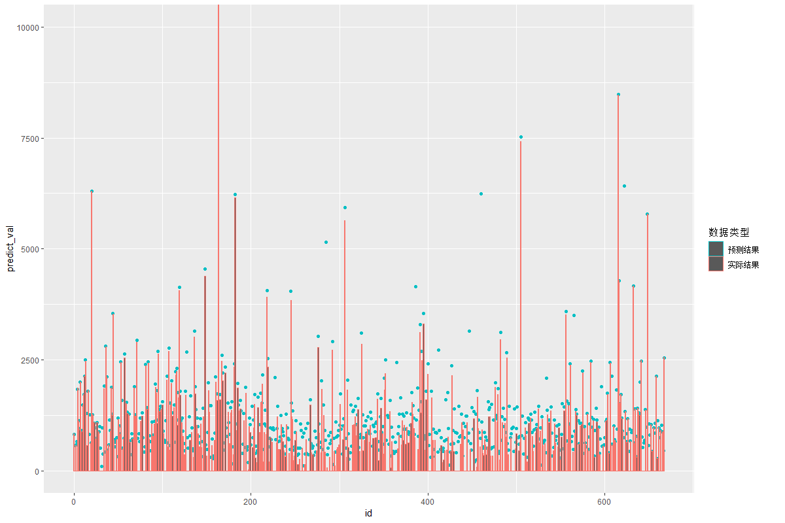
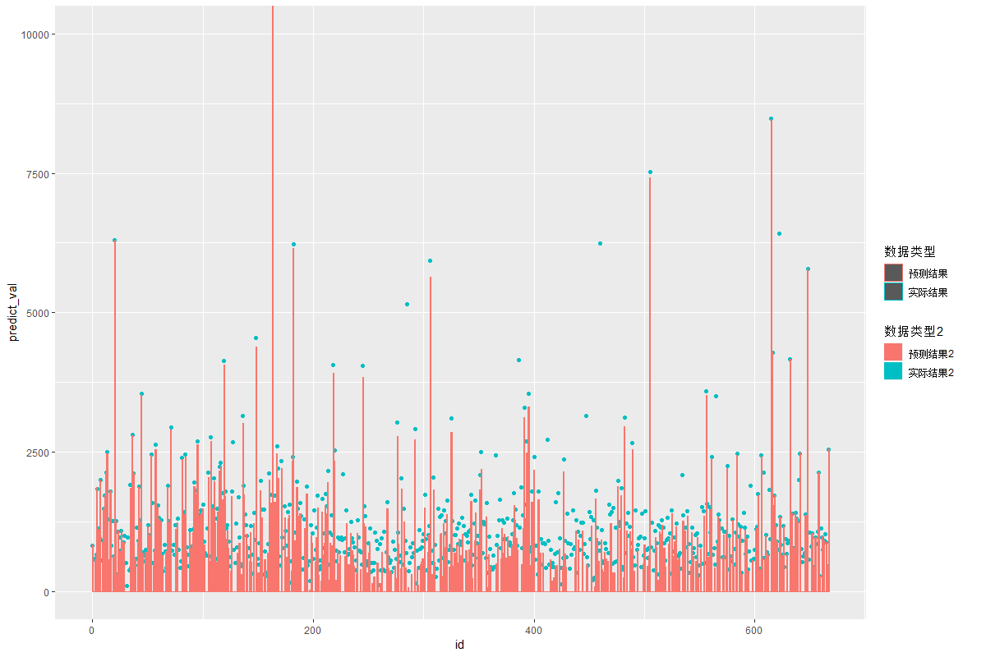
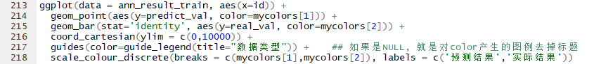
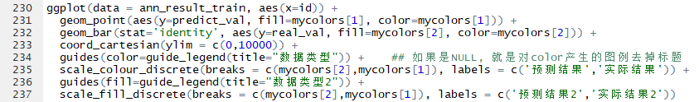
Process of Plotting

Slide 11

Process of Plotting

Slide 12
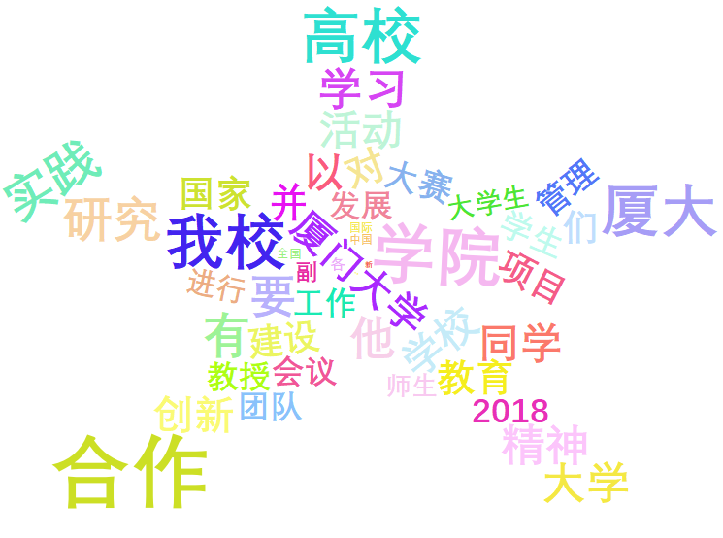
Word Cloud
Content of Word Cloud
Word
Word frequency

Slide 13

Word Cloud
Individual word examinable

Slide 14
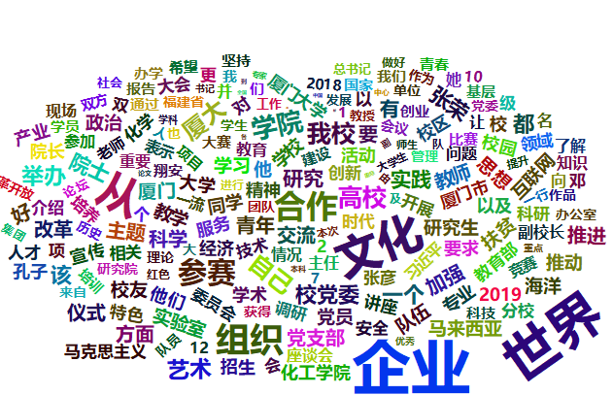
Word Cloud
Shape & size & font customizable

Slide 15
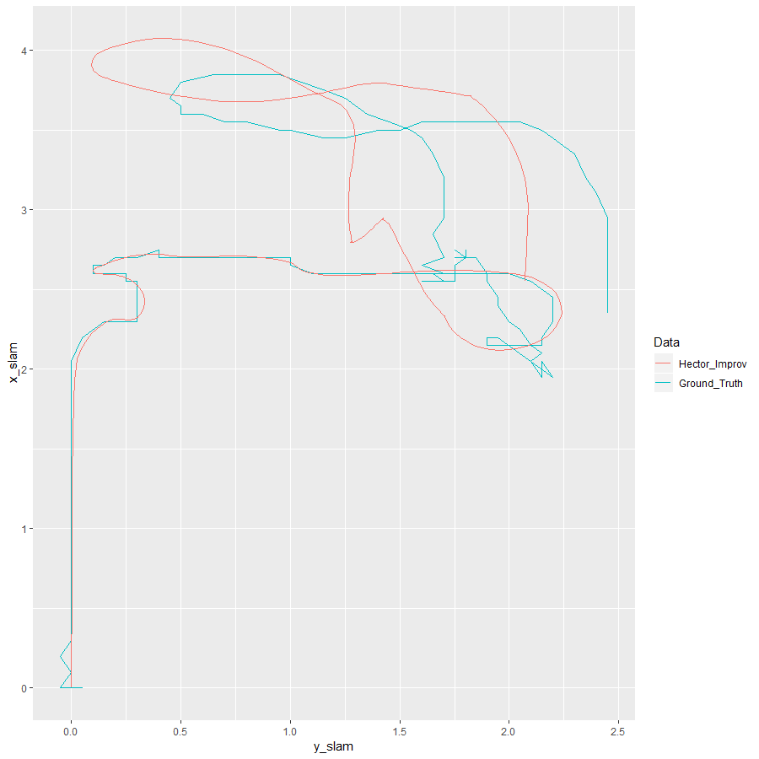
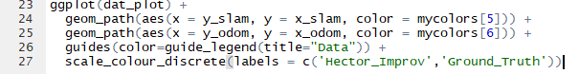
Trajectory Plotting
My CURRENT work
What is primarily needed?
A clear comparison between SLAM trajectory and ground truth

Slide 16
Trajectory Plotting
Good representation but too slim

Slide 17
Trajectory Plotting

Slide 18
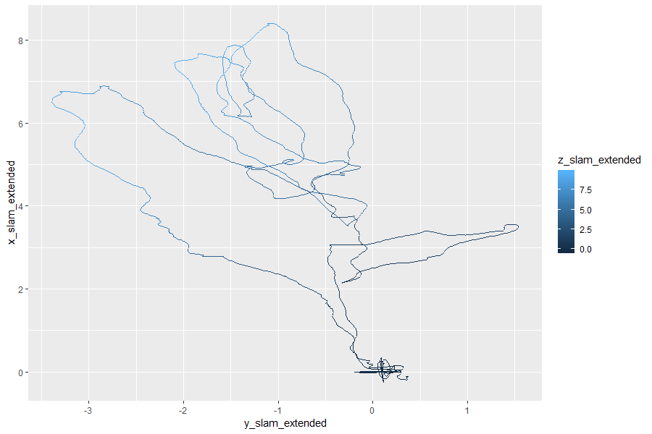
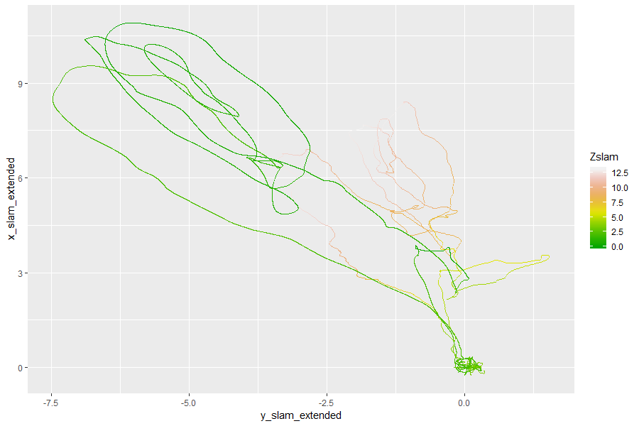
Trajectory Plotting
Demonstrate flight altitude for micro aerial vehicle (MAV) SLAM

Slide 19
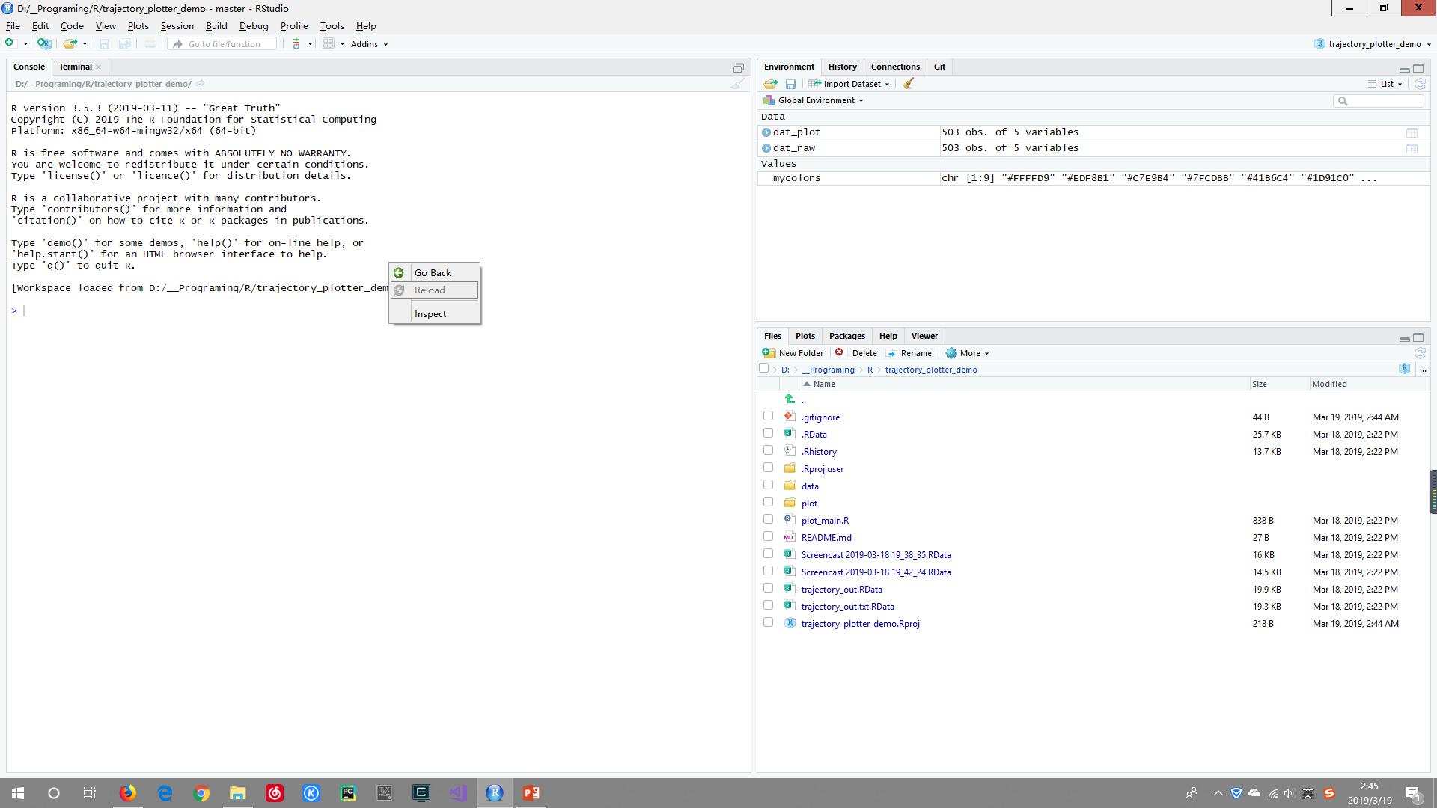
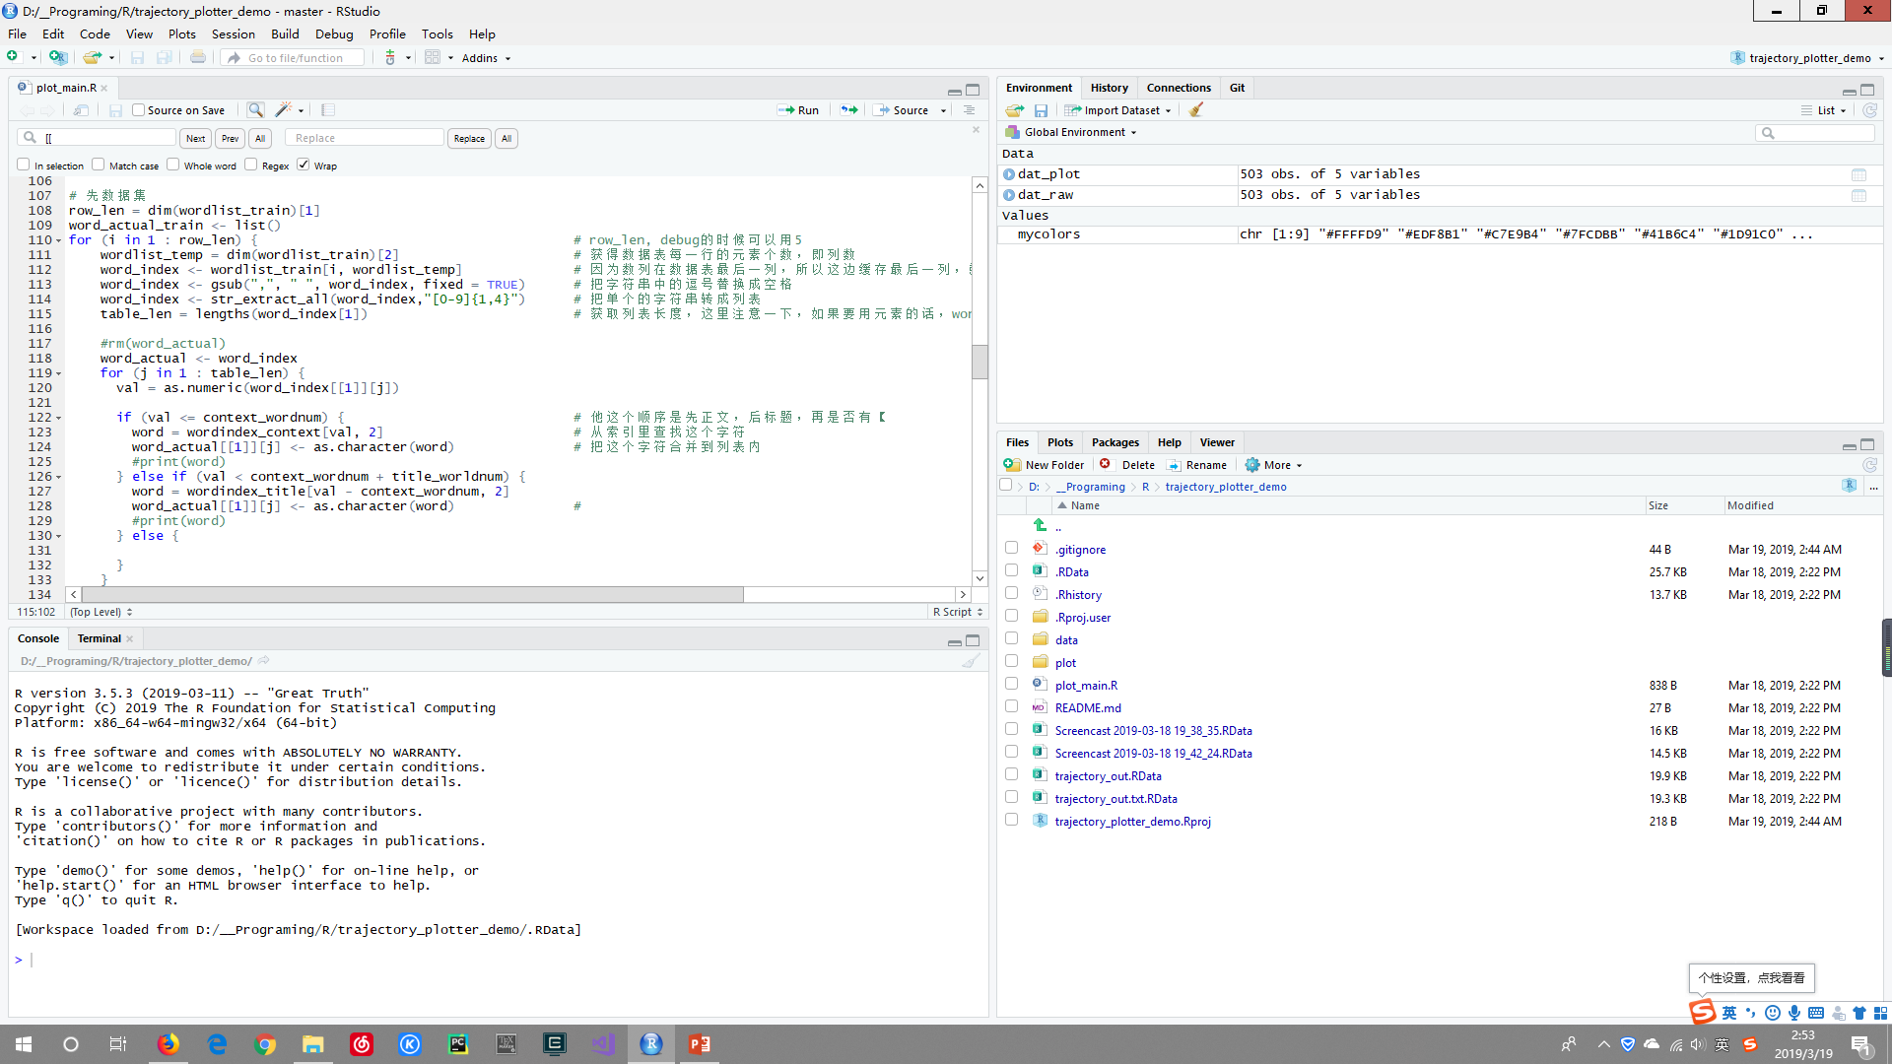
Feeling & Deep Thinking
Advantages
Beautiful plotting
Good statistical functions
“Strange” interpreter, still running after encountering errors
Disadvantages
Lack of string manipulation methods, especially EXTRACTION method
Strange RStudio
Unclear variable type
Not as flexible as C/C++/Python/Java

Slide 20
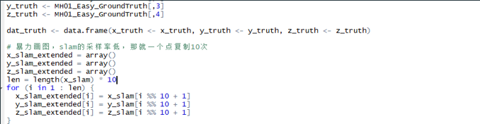
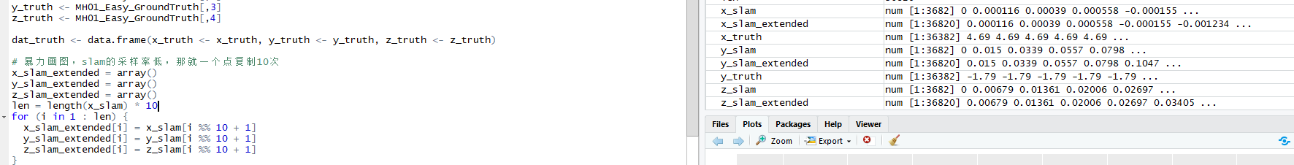
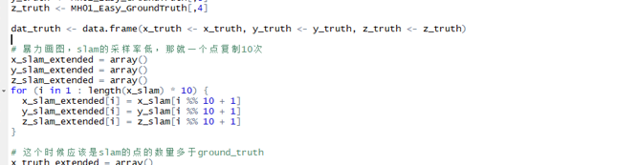
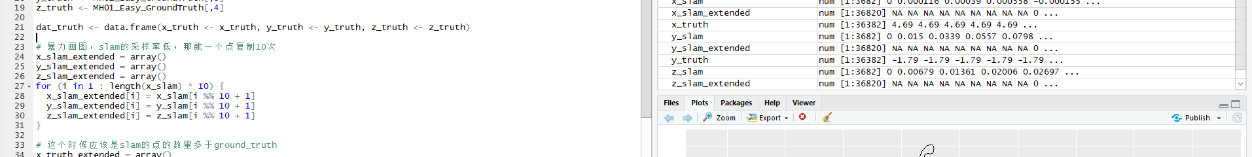
Feeling & Deep Thinking
Feelings
In R, data is much more important than the project itself.
Never try saving the unfinished data before.
A good tool for after-experiment processing.

Slide 21
Thanks for listening!

